Slide 1
1st Platoon Mooninite Website Presentation
CSC 595 ASP.Net

Slide 2
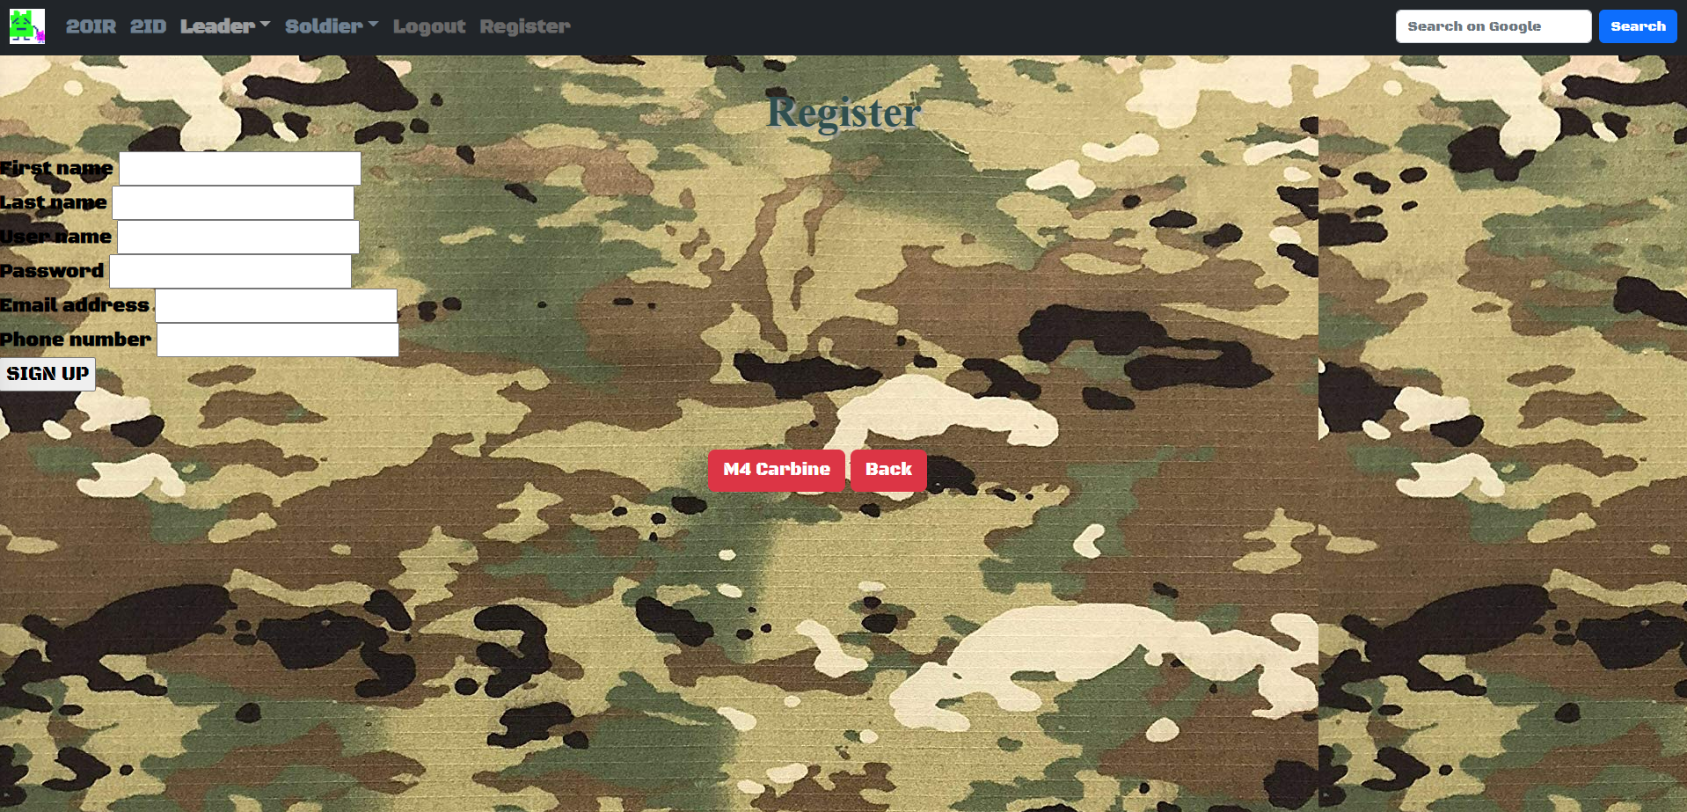
1st Platoon Mooninite Reunion Site
The project is meant to demonstrate a website soldiers from 1st Platoon, 5-20 Infantry Battalion can sign up for our 10-year Afghanistan Campaign reunion.
Register page allows the soldier to sign into the website and Add/Edit entries.

Slide 3
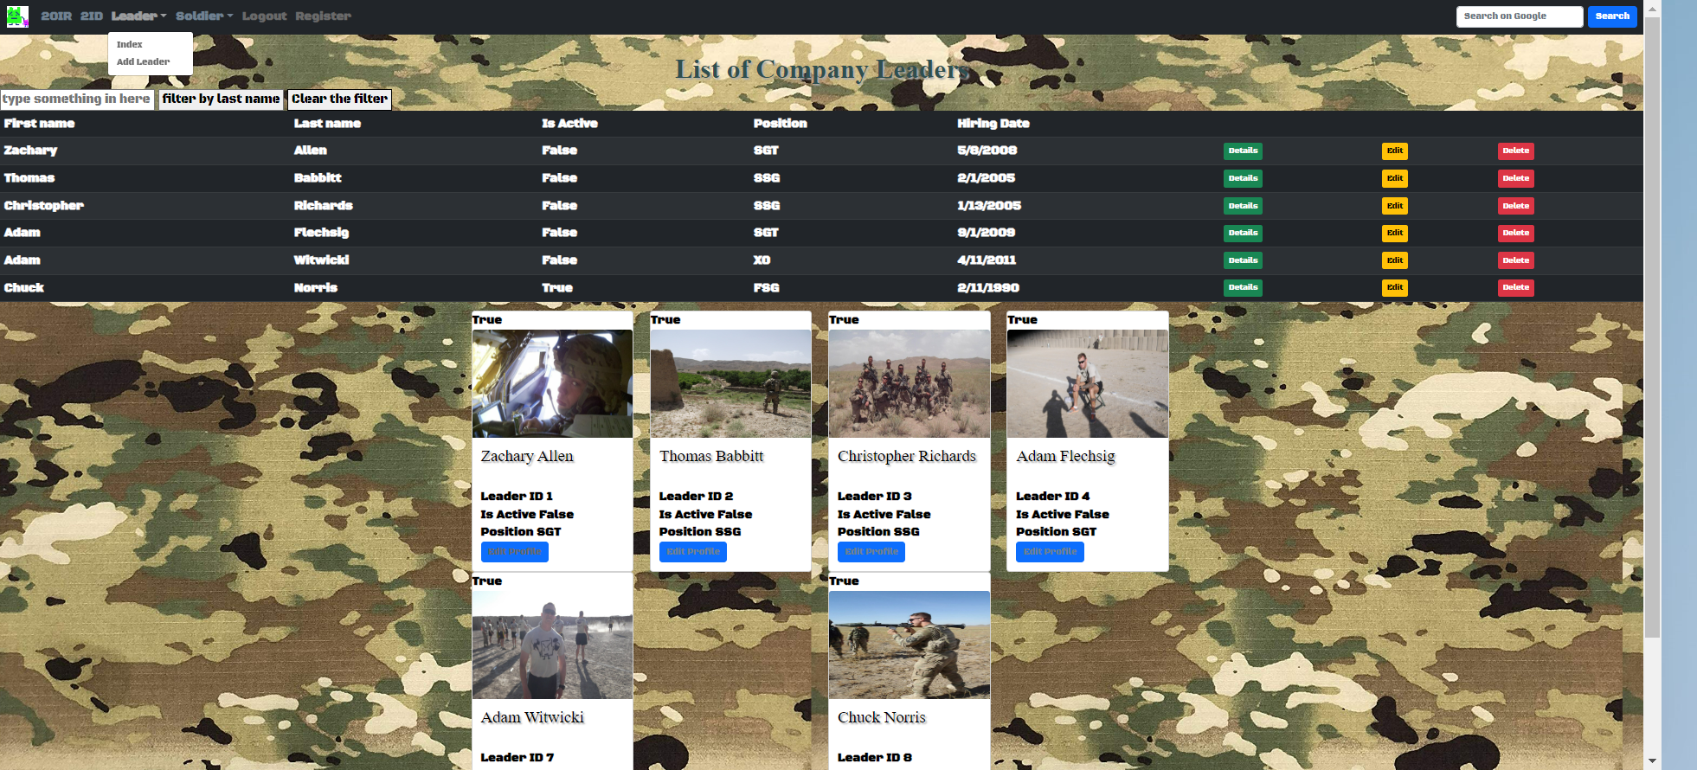
Leader Index and Add Leader Dropdown
Allows User to see Leader Index, Details, Edit or Delete a Leader

Slide 4
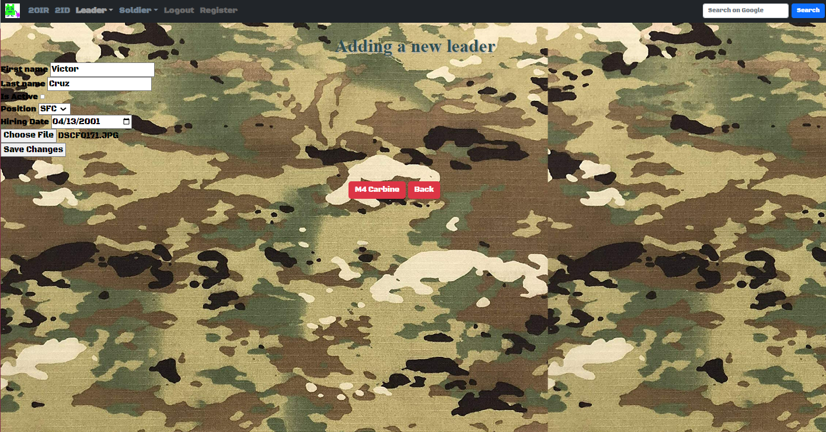
Add Leader Page
Allows Info and Picture of Leader to be added to the Leader Index

Slide 5
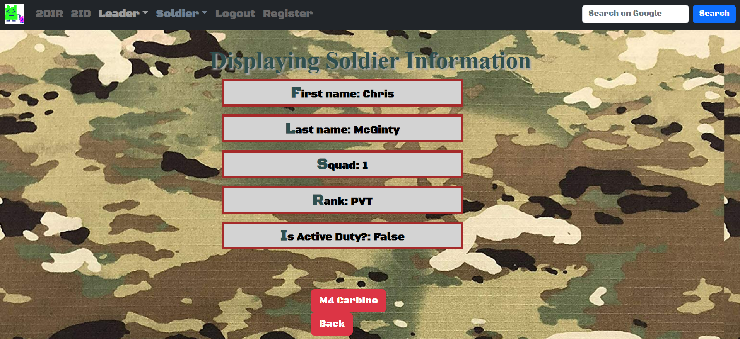
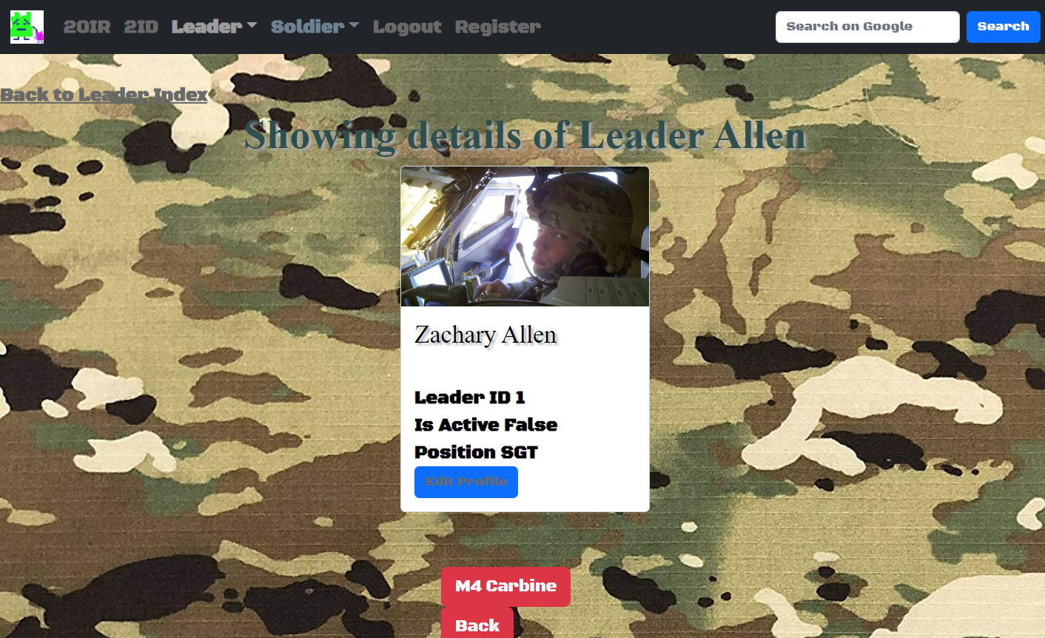
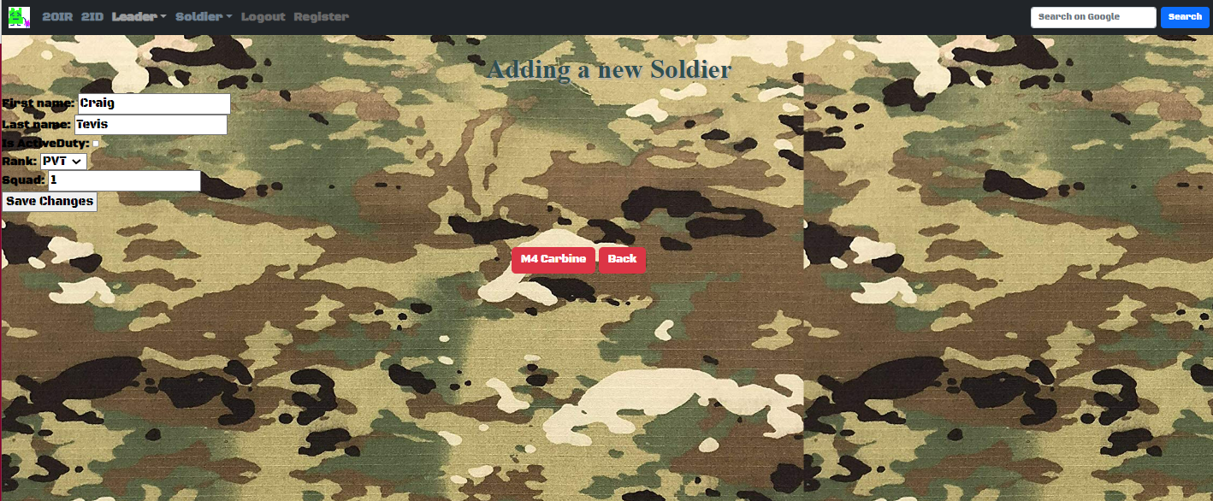
Leader Details
Displays Leader Information

Slide 6
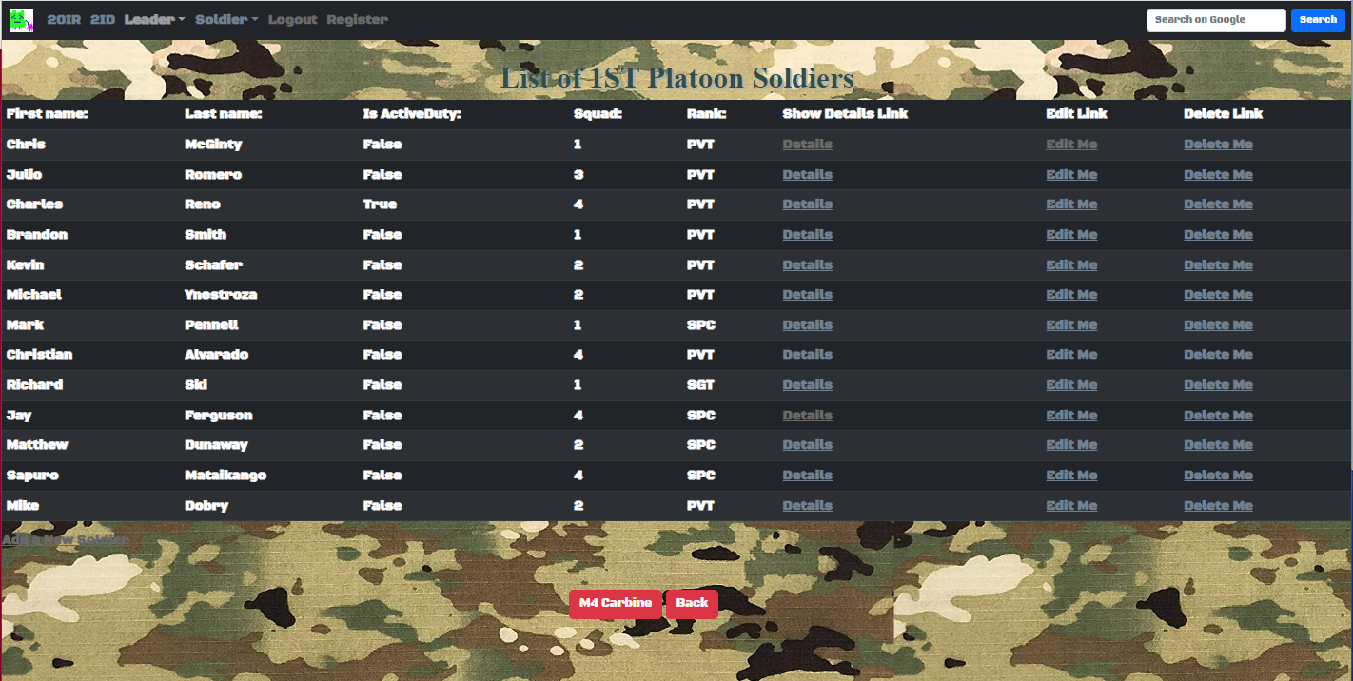
Soldier Index
Allows User to see Leader Index, Details, Edit or Delete a Leader

Slide 7
Soldier Index
Allows Info to be Added to the Soldier Index

Slide 8
Soldier Details
Displays Soldier Information

Slide 9
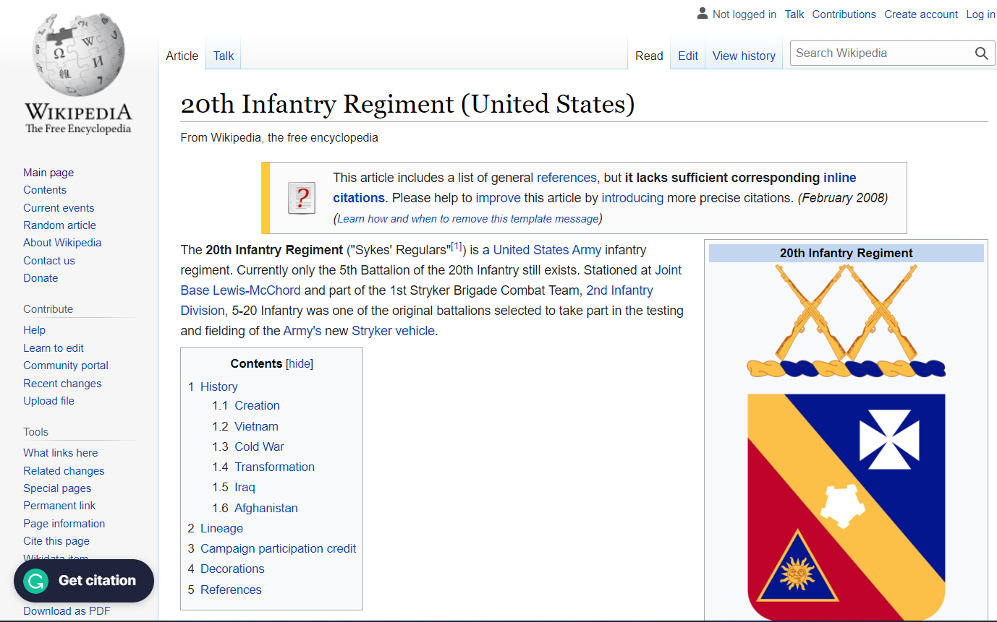
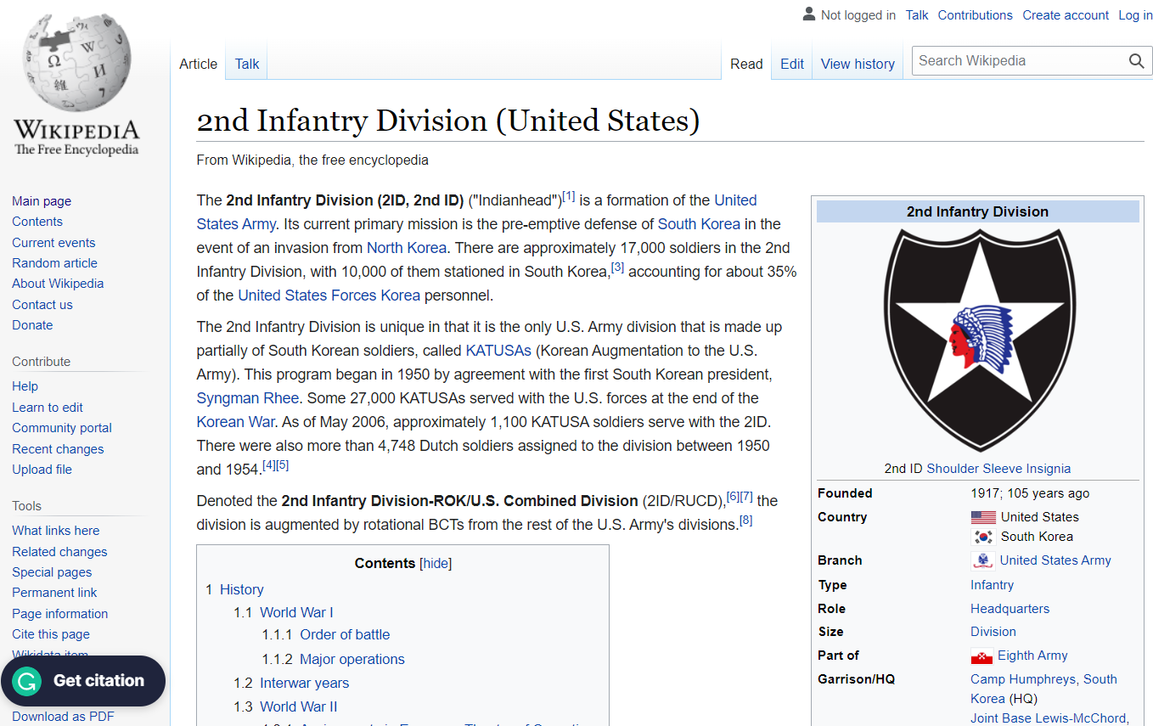
Navbar Links
20th Infantry Regiment Link
2nd Infantry Division Link

Slide 10
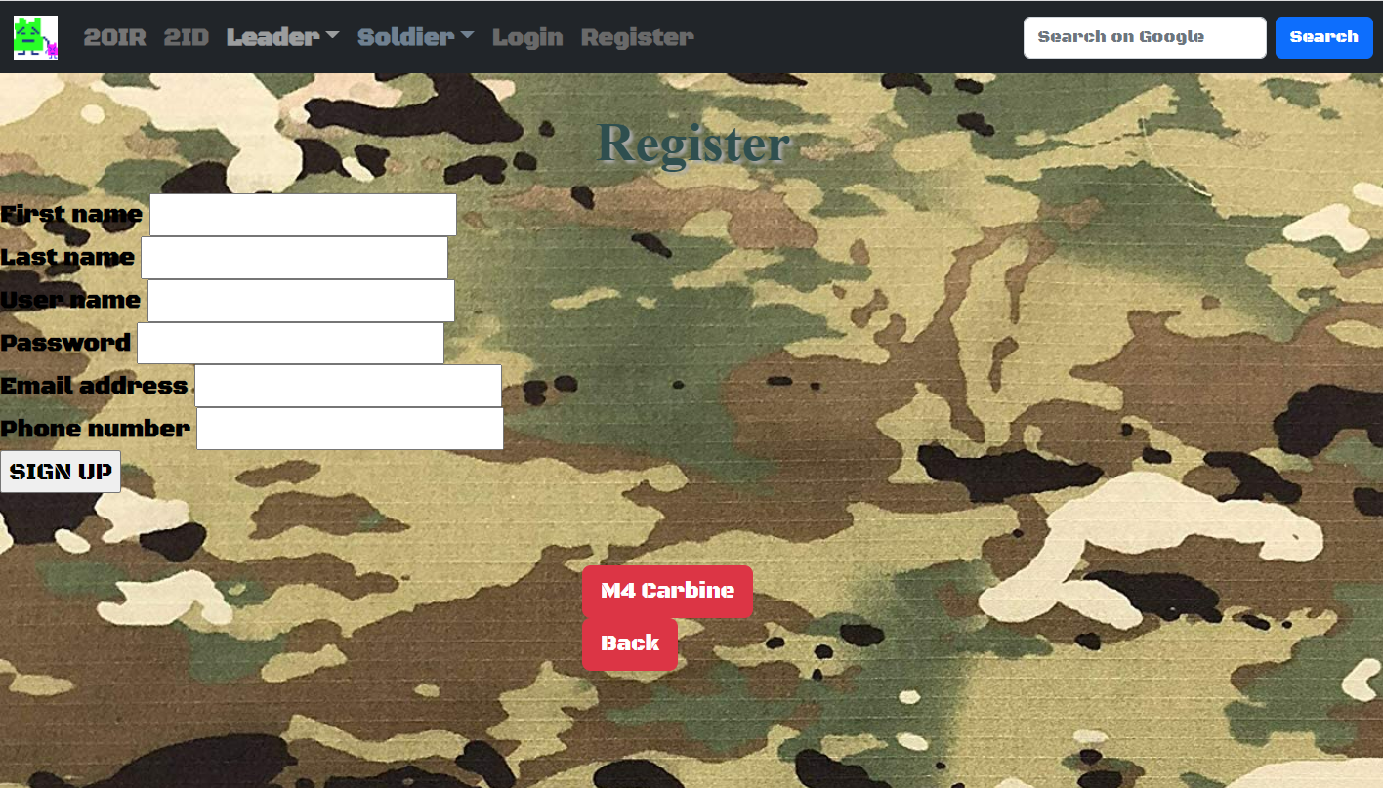
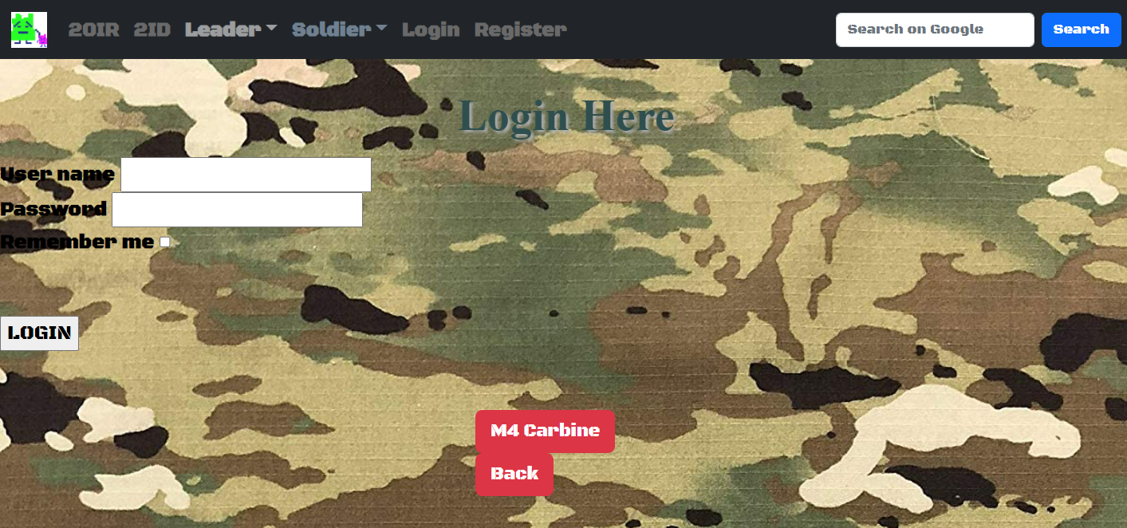

Site Access & Authentication
Register Page
Login Page

